Slide 1


HVS​
Concept of Gear Management

Slide 2

Contents
Manunal shift gear
Auto shift gear
Gear switch diagnosis
EPB linker
Gear arbitration

Slide 3
Manunal shift gear
This module consists of EGSM shift , IVI shift and ADAS shift, According to the speed, charg state, gear request, brake pedal state, accelerator pedal opening, vehicle HV state and a series of conditions to manually shift the signal, If both IVI ,ADAS and EGSM signals occur at the same time, the EGSM signal is Highest priority, ADAS Lowest. P>N: int.BrakeStatus = on P>D: int.BrakeStatus = on &VCU_HVStatus =0x2:HV ready/0x3:Drive ready&VCU_AccelerationPedal≤ cal. APOff (Default:3%, TBD) & VCU_AccelerationPedalValid=0x1: valid P>R: int.BrakeStatus = on &VCU_HVStatus =0x2:HV ready/0x3:Drive ready &VCU_AccelerationPedal≤ cal. APOff (Default:3%, TBD) & VCU_AccelerationPedalValid=0x1: valid N>P: |int.VehicleSpeed | ≤cal.StillVehicleSpeed（Default:3km/h,TBD)
N>D: VCU_HVStatus =0x2:HV ready/0x3:Drive ready&VCU_AccelerationPedal≤ cal. APOff (Default:3%, TBD) &VCU_AccelerationPedalValid=0x1: valid &{( | int.VehicleSpeed | ≤cal.StillVehicleSpeed（Default：3km/h，TBD）& int.BrakeStatus = on) ||(int.VehicleSpeed＞cal.StillVehicleSpeed（Default:3km/h,TBD)}
N>R: VCU_HVStatus =0x2:HV ready/0x3:Drive ready&VCU_AccelerationPedal≤ cal. APOff (Default:3%, TBD) & VCU_AccelerationPedalValid=0x1: valid &{( | int.VehicleSpeed | ≤cal.StillVehicleSpeed（Default：3km/h，TBD）& int.BrakeStatus = on)|| (int.VehicleSpeed<-cal.StillVehicleSpeed（Default：3km/h，TBD）}
D>P: | int.VehicleSpeed | ≤cal.StillVehicleSpeed（Default：3km/h，TBD）
D>R: VCU_AccelerationPedal≤ cal. APOff (Default:3%, TBD) & VCU_AccelerationPedalValid=0x1: valid &{（ | int.VehicleSpeed | ≤cal.StillVehicleSpeed（Default：3km/h,TBD& int.BrakeStatus = on )||int.VehicleSpeed<-cal.StillVehicleSpeed（Default:3km/h,TBD)}
R>P: | int.VehicleSpeed | ≤cal.StillVehicleSpeed(Default:3km/h,TBD）
R>D: VCU_AccelerationPedal≤ cal. APOff (Default:3%, TBD) &VCU_AccelerationPedalValid=0x1: valid &{( | int.VehicleSpeed | ≤cal.StillVehicleSpeed（Default:3km/h,TBD& int.BrakeStatus = on )||int.VehicleSpeed＞cal.StillVehicleSpeed（Default:3km/h,TBD)}

Slide 4
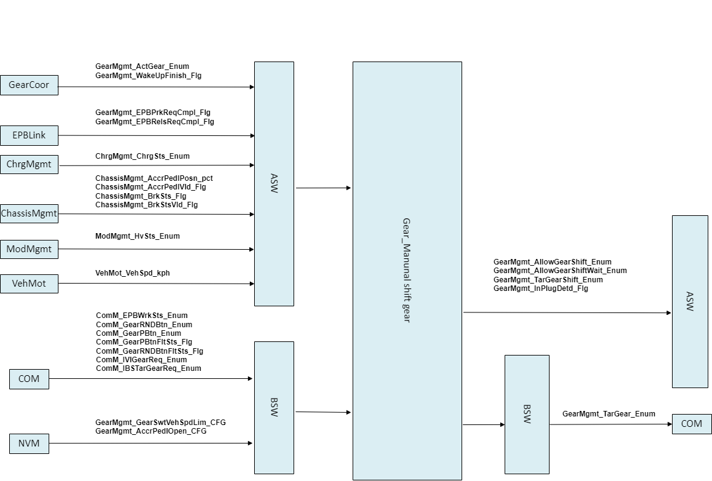
Manunal shift gear

Slide 5
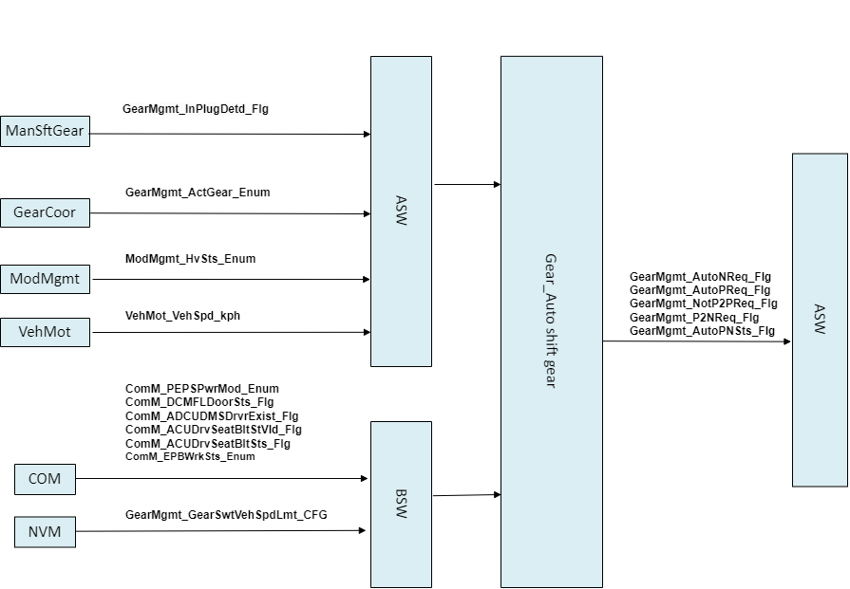
Auto shift gear
The module consists of two parts: automatic shift and EPB associated PN. Automatic switching module is divided into automatic P and automatic N. Automatic P is carried out according to the charge status, passengers leave and power OFF, and automatic N is carried out according to high voltage power off. EPB association jumps to P or N based on EPB status.

Slide 6
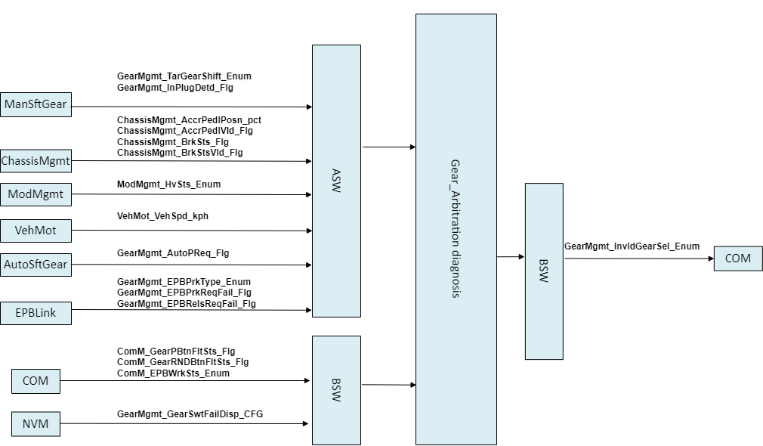
Gear switch diagnosis
The module mainly provides feedback for shifting failure, and outputs according to priority and prompt time. The brake pedal is not applied, the speed is too high, the Hv status is not satisfied, the accelerator pedal is opened too wide, the accelerator pedal is ineffective, the EGSM is faulty, and the EPB is not responsive.

Slide 7
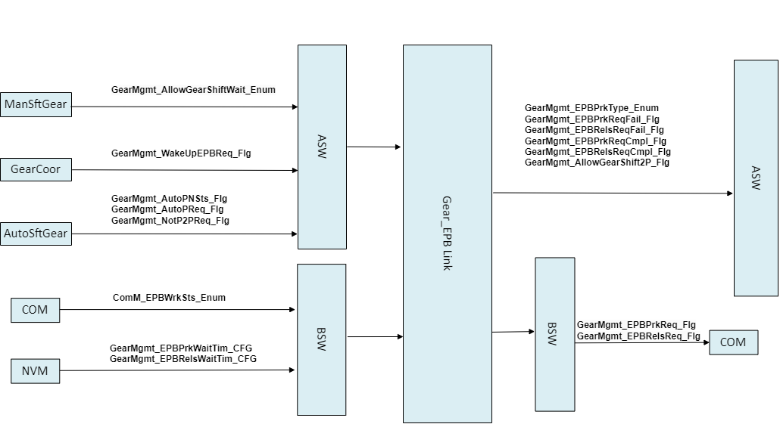
EPB linker
The main function of this module is to release the pull-up associated with an EPB and determine whether the pull-up times out or successfully jumps to the target gear according to the EPB status. In this module, the EPB type is also determined. When Auto is activated, the request for manual EPB is ignored.

Slide 8
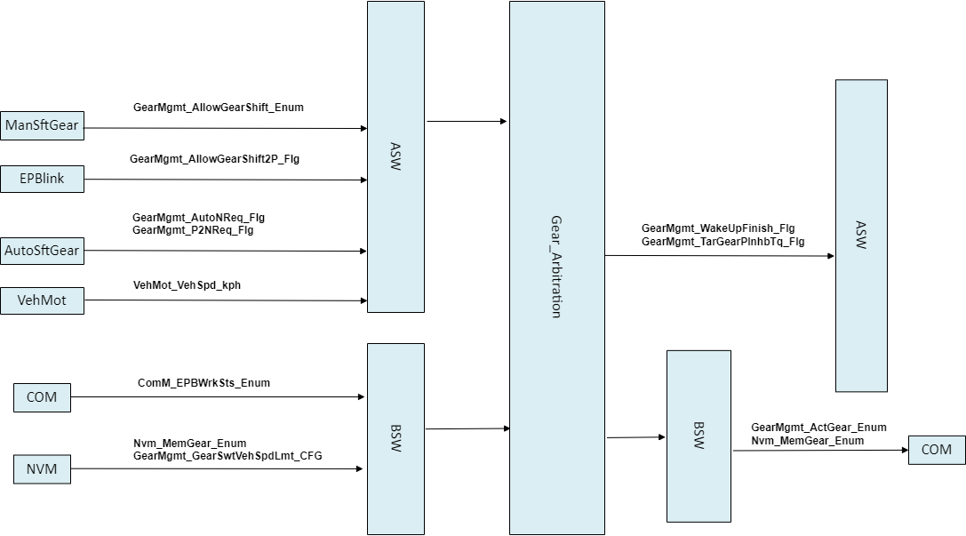
Gear arbitration
The module is responsible for the wakeup process after wakeup and the gear arbitration after wakeup. According to the signal sent by other modules, the priority is determined, autoP>autoN>manunl; The gear signal stored after power-off is assigned, and the forbidden output signal is sent to the torque module during the P process.

Slide 9
Backup

